Slide 1
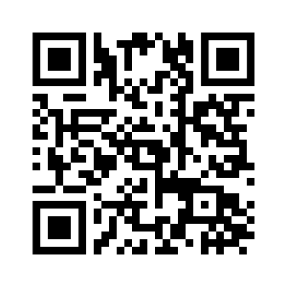
2026 Tandem Meetings
February 4-7, 2026 | Salt Lake City
Multidisciplinary event highlighting the latest research and breakthroughs in the evolving field of HCT, cellular and gene therapy.
Sessions cover basic science, translational research and clinical studies.
Tracks include:
Administrative Director, APP, Nursing, Pharmacy & more.
Learn more and register now at tandemmeetings.com or scan the QR code.

